Slide 1
CYBER 731: Assignment 3
Can You Stay Golden?
Gunnar Yonker

Slide 2
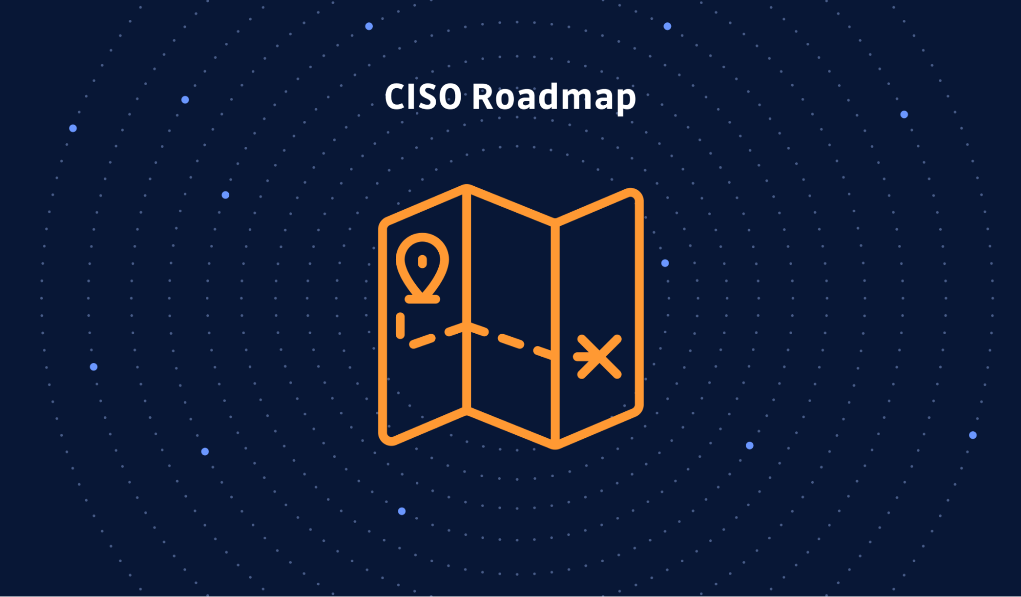
Introduction
Past Success Cyber Attack Response
Significant cyber threat of RSA breach
My Role as CISO
Swift response to incidents with effective recommendations, which led to safeguarding our classified data
Received a commendation from U.S. Space Command for ensuring the protection of sensitive information on Unidentified Aerial Phenomena (UAP)s after response to the previous RSA breach
Leadership’s Request to Enhance Security Measures
Recognition of proactive measures to maintain the company’s security posture
Expectation for CISO to build upon the previous success and provide a set of standards, policies, and governance for data security
Objective of this Presentation
Three strategies for standards, policies, and governance to further strengthen data security
Focus on proposing effective measures to prevent future cyber threats, mitigate risks, and ensure the company’s resilience against security incidents
https://blog.gitguardian.com/ciso-roadmap-first-90-days/

Slide 3
Standards
Importance of Standards
Provide a framework for consistent and effective security practices
Adopting a Security Framework
Industry-recognized security frameworks such as NIST Cybersecurity Framework
Approach to identify, protect, detect, respond, and recover from cyber threats
Encryption Standards
Mandate the use of robust encryption algorithms and protocols across the company
Protect data at rest, in transit, and in use
Prevent unauthorized access and data exfiltration by use of encryption
Secure Configuration Standards
Define and enforce secure configurations for all systems and devices
Hardening operating systems, patching software regularly, and implementing appropriate network segmentation
This will minimize vulnerabilities and reduce the attack surface for potential adversaries
Regularly Audit and assess compliance with configuration standards to ensure ongoing security

Slide 4
Policies
Acceptable Use Policy
Define acceptable and prohibited actions related to company resources
Address proper use of email, internet, software, and data handling
Promote responsible behavior and prevent inadvertent security breaches
Password Policy
Implement a strong password policy that aligns with industry best practices
Enforce the use of complex passwords, regular password changes, and multi-factor authentication
This ensures the integrity of user accounts and mitigates some of the risk of unauthorized access
Data Classification Policy
Categorize data based on its sensitivity and criticality
Define appropriate security controls and access rights for each classification level
Enable targeted protection measures based on the value and potential impact of the data
Incident Response Policy
Establish a documented incident response plan outlining the step-by-step procedures to be followed
Define roles, responsibilities, and procedures for responding to security incidents effectively and efficiently
Include communication protocols, escalation procedures, and how to coordinate with external entities such as law enforcement

Slide 5
Governance
Security Metrics and Reporting
Define key security metrics to measure the effectiveness of security controls
Regularly report to leadership on security metrics, incidents, and trends
Enable data-driven decision-making and ensure transparency regarding the organization’s security performance
Compliance and Auditing
Regularly conduct internal and external audits to assess compliance with policies and standards
Identify any gaps or non-compliance issues promptly and remediate them effectively
Demonstrate a commitment to regulatory requirements and industry standards to maintain trust and credibility
Security Awareness and Training Program
Implement a comprehensive program to educate employees on security best practices
Regularly update training content to address emerging threats and social engineering techniques
Foster a culture of security awareness and empower employees to be the first line of defense
Security Risk Management
Establish a risk management framework to identify, assess, and prioritize risks to the company’s data security
Conduct regular risk assessments and adapt security measures accordingly

Slide 6

Conclusion
Three Strategies
Standards
Policies
Governance
Importance of a holistic approach to data security that encompasses the following three factors:
Technical
Operational
Human
Full confidence that with these proposed strategies to enhance data security will help to effectively defend against cyber attacks and mitigate future risks
https://stock.adobe.com/images/desktop-computer-and-lock-on-screen-computer-security-password-privacy-confidential-information-protection-concepts-premium-quality-modern-flat-design-graphic-elements-vector-illustration/144532122

